Slide 1
Epistemology 3 MOT142A Q2
Dr Jack Casey

Slide 2
Recap of last weeks topics
Last week we looked at:
arguments, truth, and validity
truth tables, how to construct them, and how to use them to test the validity of arguments

Slide 3
Recap of last weeks topics
Few of you asked why we were looking at formal logic
Aside from intrinsic value of logic (if there is any), there are two reasons:
Practical – a lot of employers look for critical thinking skills, and I’ve been told a number of consultancy firms actually include formal logic components on their application tests
Theoretical – we’ll deploy the skills we learned last week in understanding arguments about scientific knowledge in this week’s lecture and tutorials

Slide 4
Aims for this week
This week, we will consider:
Difference between deduction and induction more closely
The shortcomings of inductive reasoning, and how it features within science.
Falsificationism
The empirical cycle

Slide 5
Recap on deduction
Deductive reasoning is truth preserving.
That is, when an argument is deductively valid, and the premises are true, we can be guaranteed that the conclusion is also true.
In this way, we can reach novel truths, just by application of logical rules to truths we’re already aware of.
Mathematics exemplifies the greatest successes of the use of this model.

Slide 6
Deduction vs. Induction
Scientific reasoning, however, is much more reliant on inductive reasoning.
Inductive reasoning is on far shakier ground.
The truth of the premises, in an inductively valid argument, DO NOT guarantee the truth of the conclusion.

Slide 7
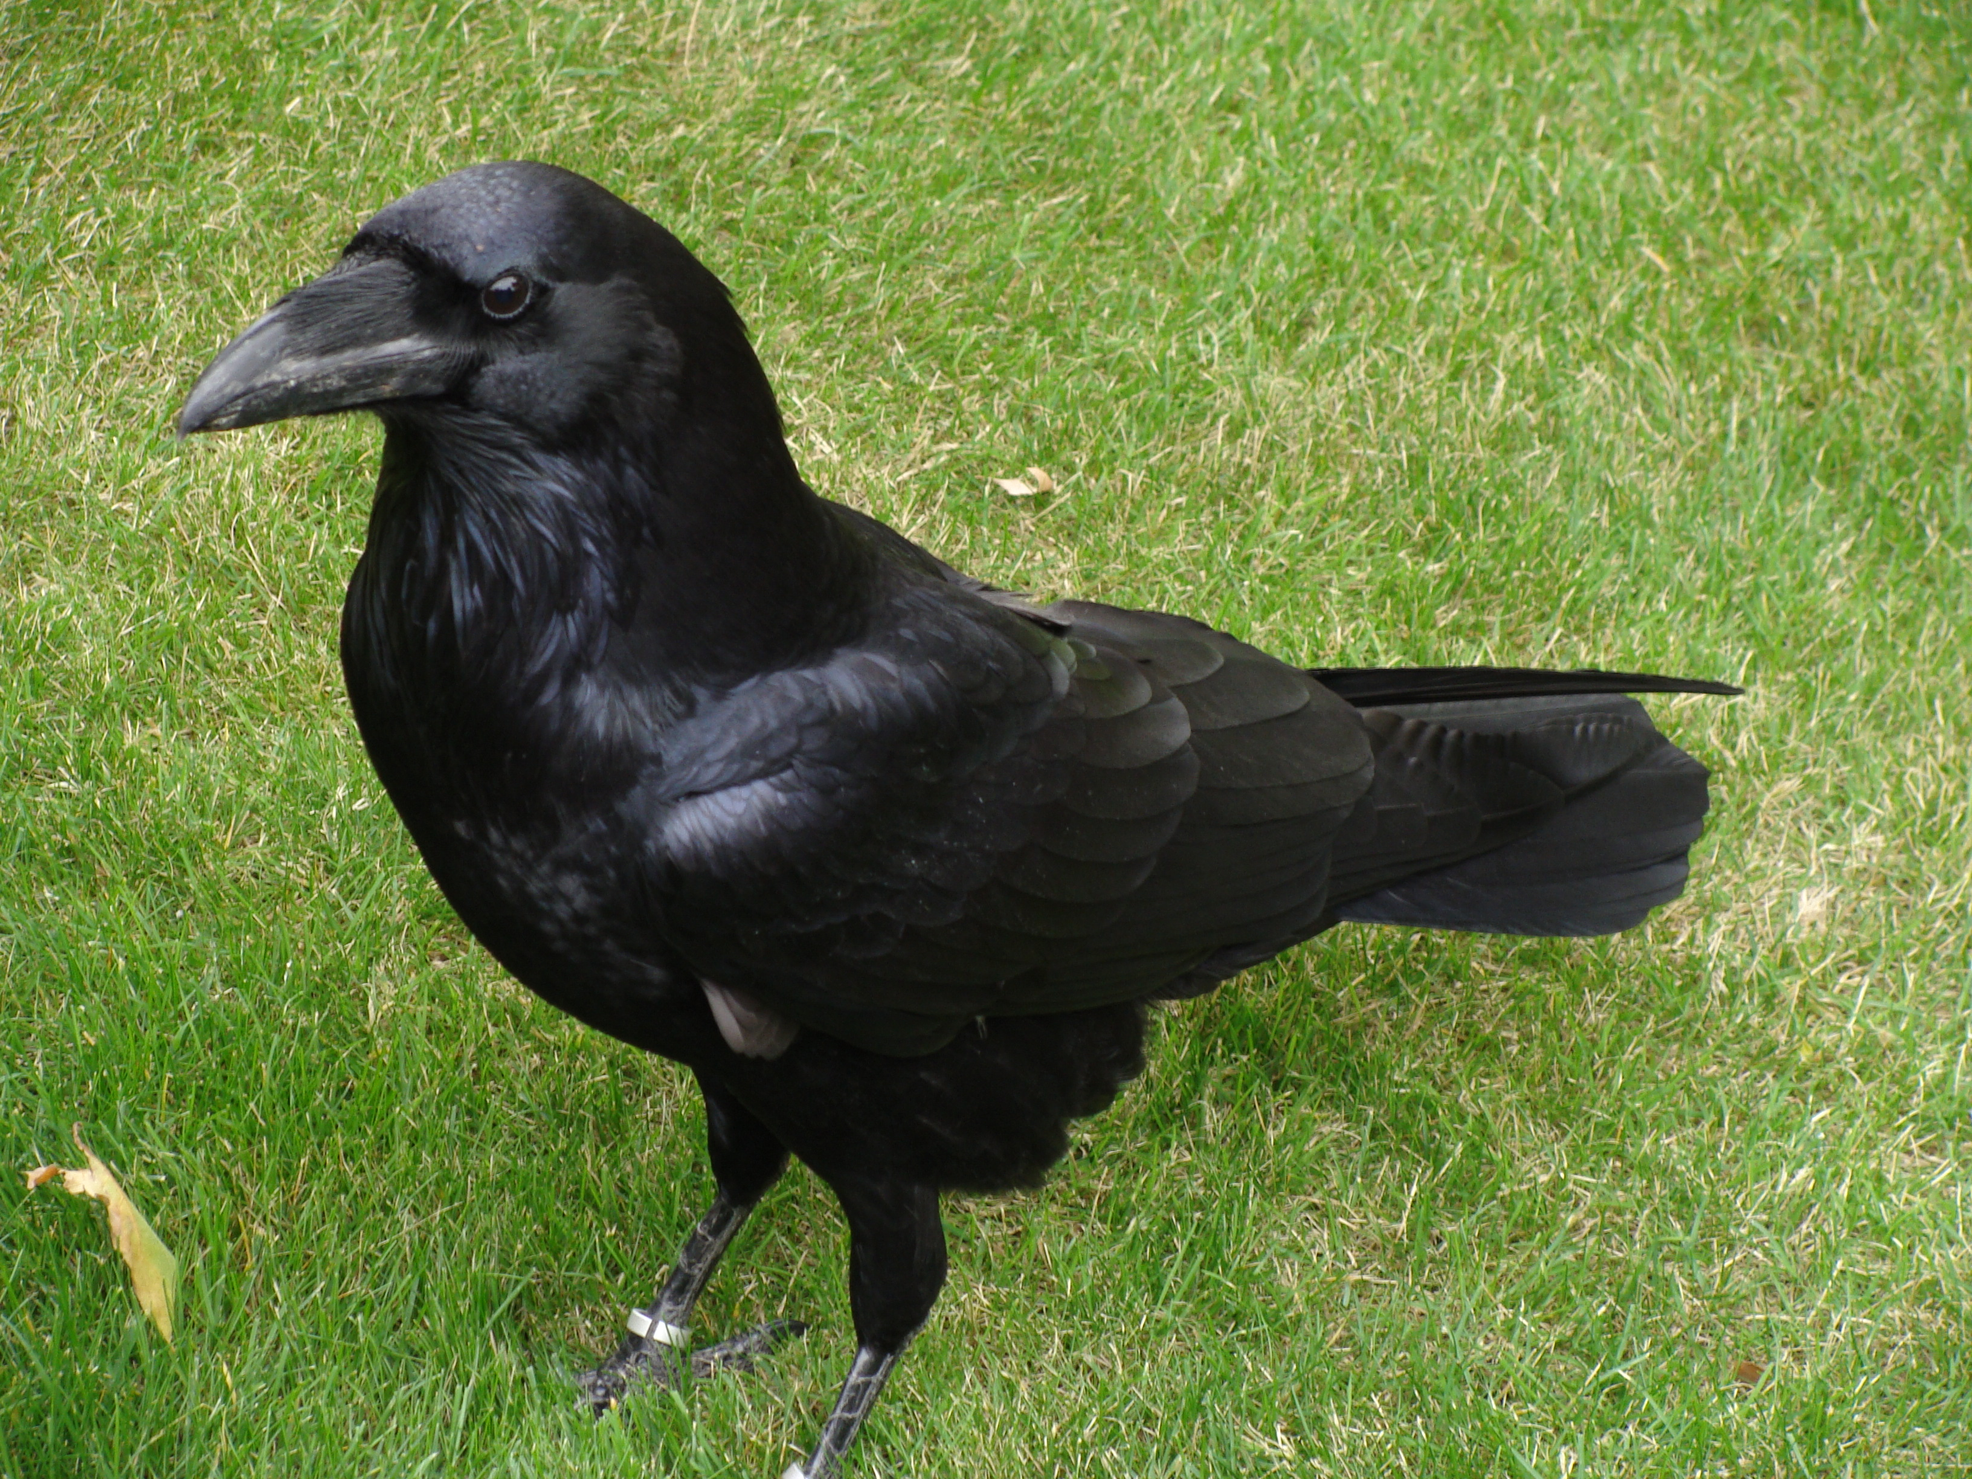
Recap on deduction
Deductive argument:
P1. All ravens are black.
P2. The next raven I see will be black.
Inductive argument
P1. All ravens I’ve ever observed have been black
C. The next raven I see will be black.

Slide 8
Deduction vs. Induction
The truth of the conclusion is guaranteed by a deductively valid argument and the truth of the premises – that’s what it is for an argument to be deductively valid.
Not so for inductive arguments.
While I might feel more assured of seeing a black raven, given the fact all previous ravens I’ve seen have been black, I cannot guarantee that the next one I see will be black.
Instead, an inductively valid argument means the conclusion is likely, given the truth of the premises.

Slide 9
Deduction vs. Induction
How might we justify inductive reasoning, then?
Here’s one possible method:
I use a lot of inductive reasoning in my day-to-day life all the time, and it’s always served me well.
The sun has risen every day before today, and on this basis, I suppose that it will do tomorrow.
Every time I’ve eaten a meal, my hunger dissipates, and I suppose that pattern will continue, as well.
When I flick the light switch, the light comes on, and so on.
Given that inductive reasoning has always served me well in these circumstances, I can be assured that it will continue to do so.

Slide 10
Deduction vs. Induction
What do you think of this justification of inductive reasoning?
I use a lot of inductive reasoning in my day-to-day life all the time, and it’s always served me well.
The sun has risen every day before today, and on this basis, I suppose that it will do tomorrow.
Every time I’ve eaten a meal, my hunger dissipates, and I suppose that pattern will continue, as well.
When I flick the light switch, the light comes on, and so on.
Given that inductive reasoning has always served me well in these circumstances, I can be assured that it will continue to do so.

Slide 11
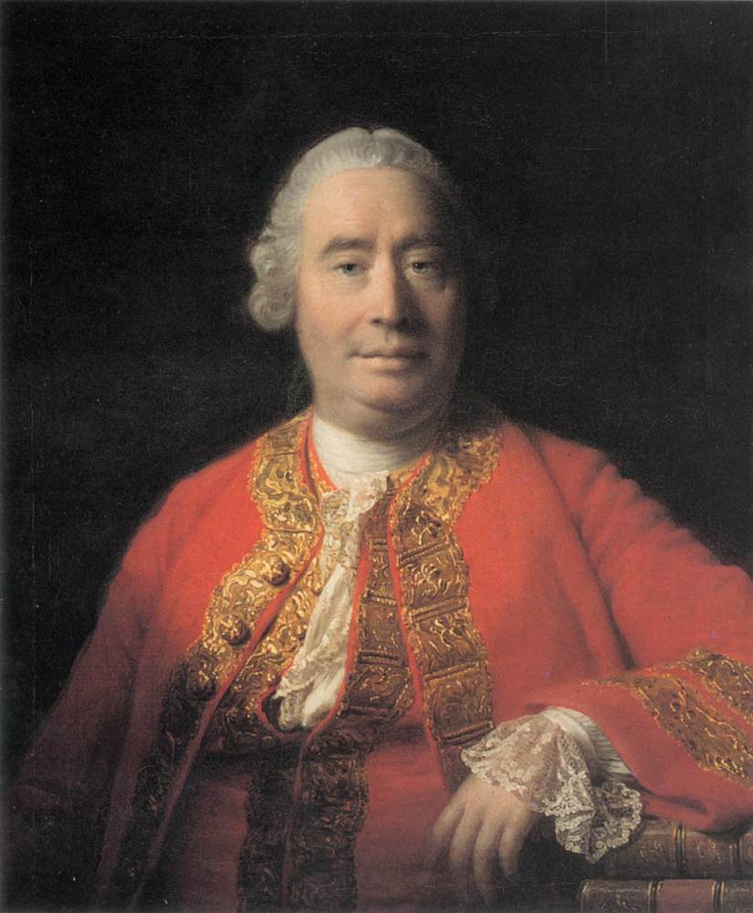
Deduction vs. Induction
Problem of Induction
We can’t justify inductive reasoning with inductive reasoning. To do so would be circular.
Compare: Why X? Because X.

Slide 12
Deduction vs. Induction
Why does the problem of induction matter?
Well, it’s hugely problematic, as inductive reasoning is at the cornerstone of scientific reasoning.

Slide 13
Laws of Nature
Laws of nature are, very simply, generalisations of the form ‘All Xs that are Fs, are also Gs’.
All metals are good conductors of electricity
All uranium-235 atoms have a half life of 703.8 million years
No massive entity can travel faster than the speed of light

Slide 14
Laws of Nature
Laws of nature are usually generalisations of the form ‘All Xs that are Fs, are also Gs’.
All metals are good conductors of electricity
All Xs that are Fs (metals) are also Gs (good conductors of electricity).
All uranium-235 atoms have a half life of 703.8 million years
All Xs that are Fs (uranium-235 atoms) are also Gs (have a half life of 703.8 million years).
No massive entity can travel faster than the speed of light
All Xs that are Fs (havers of mass) are also not-Gs (travel faster than speed of light).

Slide 15
Laws of Nature
Let's take one example:
All metals are good conductors of electricity

Slide 16
Laws of Nature
How might we prove this sentence to be true?
All metals are good conductors of electricity
Well, it might look something like this:
P1. Mercury is a metal, and mercury is a good conductor of electricity.
P2. Iron is a metal, and iron is a good conductor of electricity.
P3. Copper is a metal, and copper is a good conductor of electricity.
…
C. All metals conduct electricity well.

Slide 17
Laws of Nature
‘All metals are good conductors of electricity’
What is the problem with this picture?
It’s always logically possible that we subsequently observe a novel X that is 1) a metal, and 2) is a poor conductor of metal
The truth of our conclusion isn’t guaranteed by the truth of the premises
Note: we can’t say that our theory says that such an X is physically impossible – the theory is the thing we’re trying to justify.
Inductive reasoning then cannot guarantee the truth of the laws of nature

Slide 18
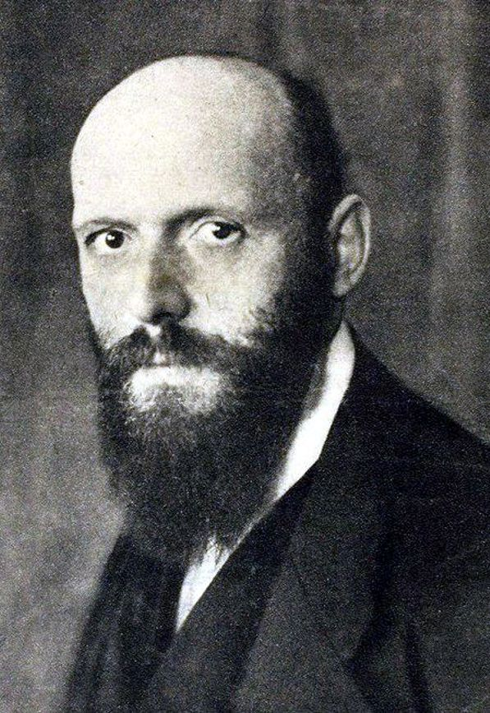
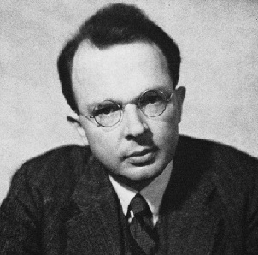
Verificationism
‘All metals are good conductors of electricity’
The preceding discussion highlights the fatal flaw that exists within the verificationist project
Verificationism is the philosophical project that states that a statement is only meaningful when we can empirically verify it
Greatest exponents are widely known as the Vienna Circle (logical positivists)
Main aim of the logical positivists was to rid us of statements of theology, metaphysics, ethics, etc., on the basis that they were meaningless
As we can see, this criterion of meaningfulness is too stringent, in so far as it will undermine any universal generalisations
We cannot verify universal generalisations, as there’s always the logical possibility that a counterexample exists – no empirical observation can verify such generalisations

Slide 19
Laws of Nature
Since laws are at the cornerstone of science, what are we to do?
It seems our main methodology in science is in grave jeopardy. If we have no justifiable methodology, why should we trust the knowledge science purports to produce?

Slide 20
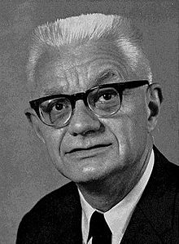
Hypothetico-Deductive Model
Hypothetico-deductive model
Proposed by Carl Hempel in the 1950s
What is it? A proposed description of the scientific method
The rough idea is this: scientific enquiry proceeds not by producing statements which we then justify inductively, but instead, by producing falsifiable statements that we can then test.
Helps us understand also how theories, rather than just statements, might be falsified.

Slide 21
Hypothetico-Deductive Model
Rather than try to justify the inductive inferences we make personally to reach laws, we simply bypass this part, and test the laws themselves deductively
We treat those laws as hypothetical, and then test them

Slide 22
Hypothetico-Deductive Model
We test them using the following schema:
P1. If Theory T is true, then if condition C obtains, we can observe E to be the case.
P2. C obtains but E is not the case.
C. Theory T is false.

Slide 23
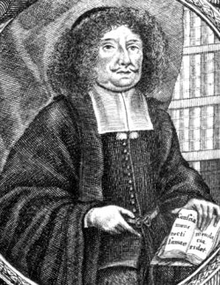
Hypothetico-Deductive Model
Consider the following example:
Becher’s phlogiston theory postulated the existence of a fire-like element, phlogiston, that was released by bodies during combustion.

Slide 24
Hypothetico-Deductive Model
We can apply the hypothetico-deductive model to Becher’s theory
Observation: when we burn steel wool, it gets heavier.
For example:
P1. If phlogiston theory is true, then when we burn steel wool, we can observe that mass is lost by that steel wool by the release of phlogiston.
P2. We burn steel wool, but the steel wool gains mass.
C. Phlogiston theory is false.

Slide 25
Hypothetico-Deductive Model
For example:
P1. If Theory T is true, then if condition C obtains, we can observe E to be the case.
P2. C obtains but E is not the case.
C. Theory T is false.
Is this deductive or inductive?
Is this valid? How can we test?

Slide 26
Hypothetico-Deductive Model
For example:
P1. If Theory T is true, then if condition C obtains, we can observe E to be the case.
(T -> (C -> E))
P2. C obtains but E is not the case.
(C & ~E)
C. Theory T is false.
~T
Is this deductive or inductive?
Is this valid? How can we test?
T | C | E | T -> | (C -> E) | (C & ~E) | ~T
1 | 1 | 1 | 1 | 1 | 0 | 0
1 | 1 | 0 | 0 | 0 | 1 | 0
1 | 0 | 1 | 1 | 1 | 0 | 0
1 | 0 | 0 | 1 | 1 | 0 | 0
0 | 1 | 1 | 1 | 1 | 0 | 1
0 | 1 | 0 | 1 | 0 | 1 | 1
0 | 0 | 1 | 1 | 1 | 0 | 1
0 | 0 | 0 | 1 | 1 | 0 | 1

Slide 27
Hypothetico-Deductive Model
So, it’s deductively valid.
What does the model help us do, then?
It helps us establish with certainty that a statement (or body of statements, i.e., a theory) is false.
This appears to put us on firmer footing – rather than relying on induction, which always carries the risk of being wrong, we’re instead utilizing deduction, which doesn’t carry the same risk.

Slide 28
Hypothetico-Deductive Model
What it still doesn’t do, however, is help us establish that our scientific statements are true. We treat them as hypothetical.
Still, proving falsity is useful.
We are often faced with competing theories:
Relativistic vs. Newtonian Mechanics
Copernican vs. Ptolemaic models of the universe
Lamarckism vs. Darwinian theories of evolution
As such, we have a methodology for establishing which of two competing theories is correct.
The problem with this, however, is we’re just left with 1 falsified theory, and 1 that hasn’t yet been falsified. Neither are established as true.
It’s never the case that we can be sure that 1 of 2 theories is definitely true.

Slide 29
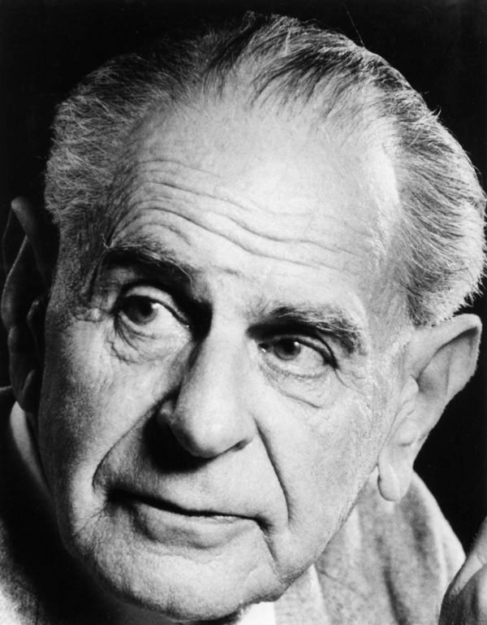
Falsificationism
This idea proved quite durable.
Karl Popper developed it further.
Falsificationism says that we cannot (and should not) hope to prove scientific statements and theories true.
Science, according to Popper, is just the process by which we eliminate statements by falsifying them; what we are left with, at the end, is science.
We don’t know what the world is like, through science, we just know what it’s not like.

Slide 30
Falsificationism
Falsificationism augments the hypothetico-deductive model by requiring that scientific theories be falsifiable.
It provides a criterion for whether an activity is, or is not, science.
As such, attempts to tackle the demarcation problem; tries to give an answer to the question of where the line is between science and pseudoscience

Slide 31
Falsificationism
Popper’s overall claim is that scientific theories must entail falsifiable predictions, or they are not scientific.

Slide 32
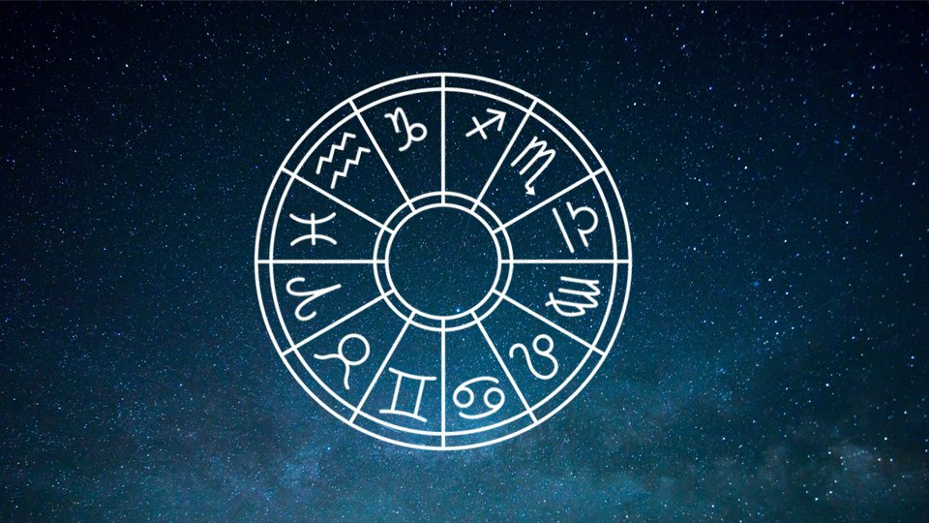
Falsificationism
Take for example, astrology.
Quite an easy case; presumably we all believe it to be pseudoscience (if it even presents itself as science).
Here’s my horoscope for today:
The hopes and goals of a group with which you're associated inspire you. You might make personal sacrifices in order to assure their success. These sacrifices are temporary, for you'll share in the group's good fortune. Personal success is also in the stars, but it may require disruptive change. Go with the flow and don't let self-doubt hold you back.
Good news for you guys!

Slide 33
Falsificationism
According to Popper, it’s pseudoscience, as this statement isn’t falsifiable.
No observation could be made, such that that observation would serve to demonstrate the falsity of that ‘prediction’
Astrology makes such vague statements, that we can’t say whether or not the statement is true or false.
Thus, astrology isn’t science.

Slide 34
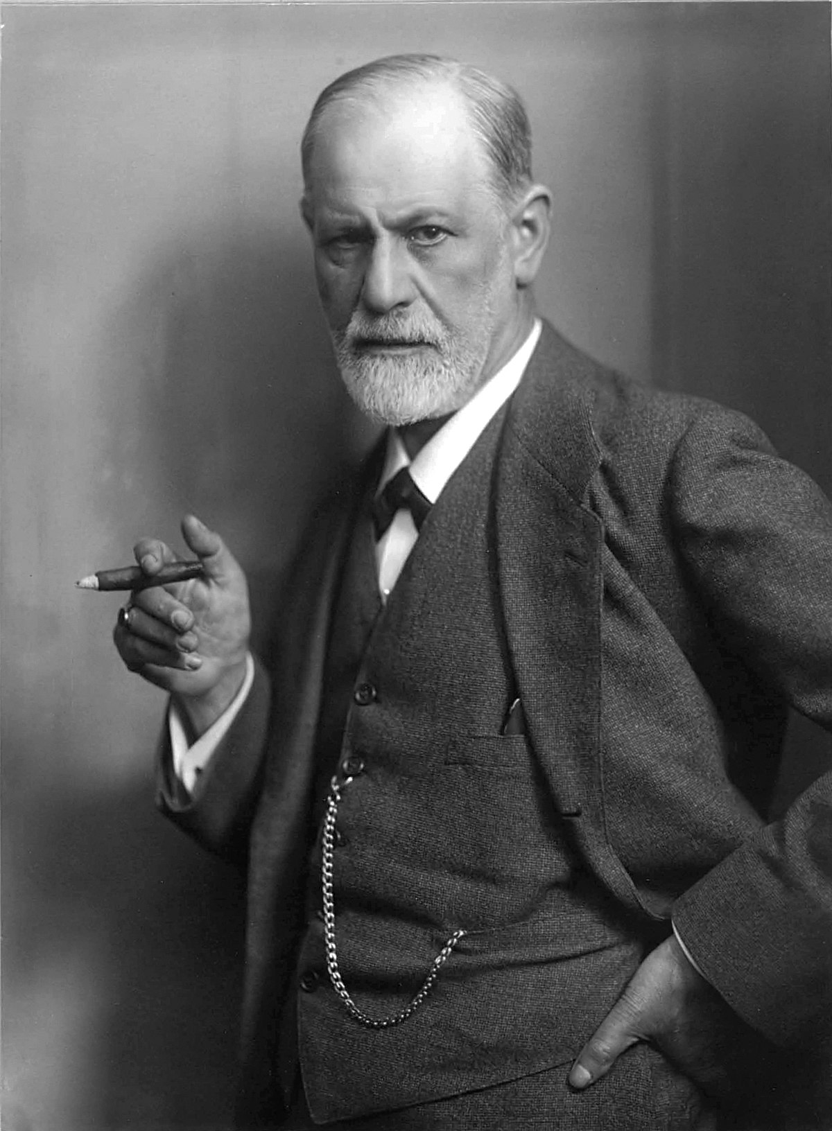
Falsificationism
More usefully, perhaps, similar criticisms exist of what we might think of as more rigorous areas of study, such as psychoanalysis.
There are very few falsifiable claims made by psychoanalysis (at least in earlier iterations).
As such, Popper viewed it as pseudoscience.

Slide 35
Falsificationism
‘…[E]very conceivable case could be interpreted in the light of Adler’s theory, or equally of Freud’s. I may illustrate this by two very different examples of human behaviour: that of a man who pushes a child into the water with the intention of drowning it; and that of a man who sacrifices his life in an attempt to save the child. Each of these two cases can be explained with equal ease in Freudian … terms. According to Freud the first man suffered from repression (say, of some component of his Oedipus complex), while the second man had achieved sublimation…

Slide 36
Falsificationism
‘I could not think of any human behaviour which could not be interpreted in terms of [the] theory. It was precisely this fact—that they always fitted, that they were always confirmed—which in the eyes of their admirers constituted the strongest argument in favour [of the theory]. It began to dawn on me that this apparent strength was in fact their weakness.’
(K. Popper, Conjectures and refutations, 1962)

Slide 37
Falsificationism
If we consider this example, the theory is amenable to both the man pushes the child in the water (call it ‘A’) and the man doesn’t push the child in the water (i.e., ‘not-A’)

Slide 38
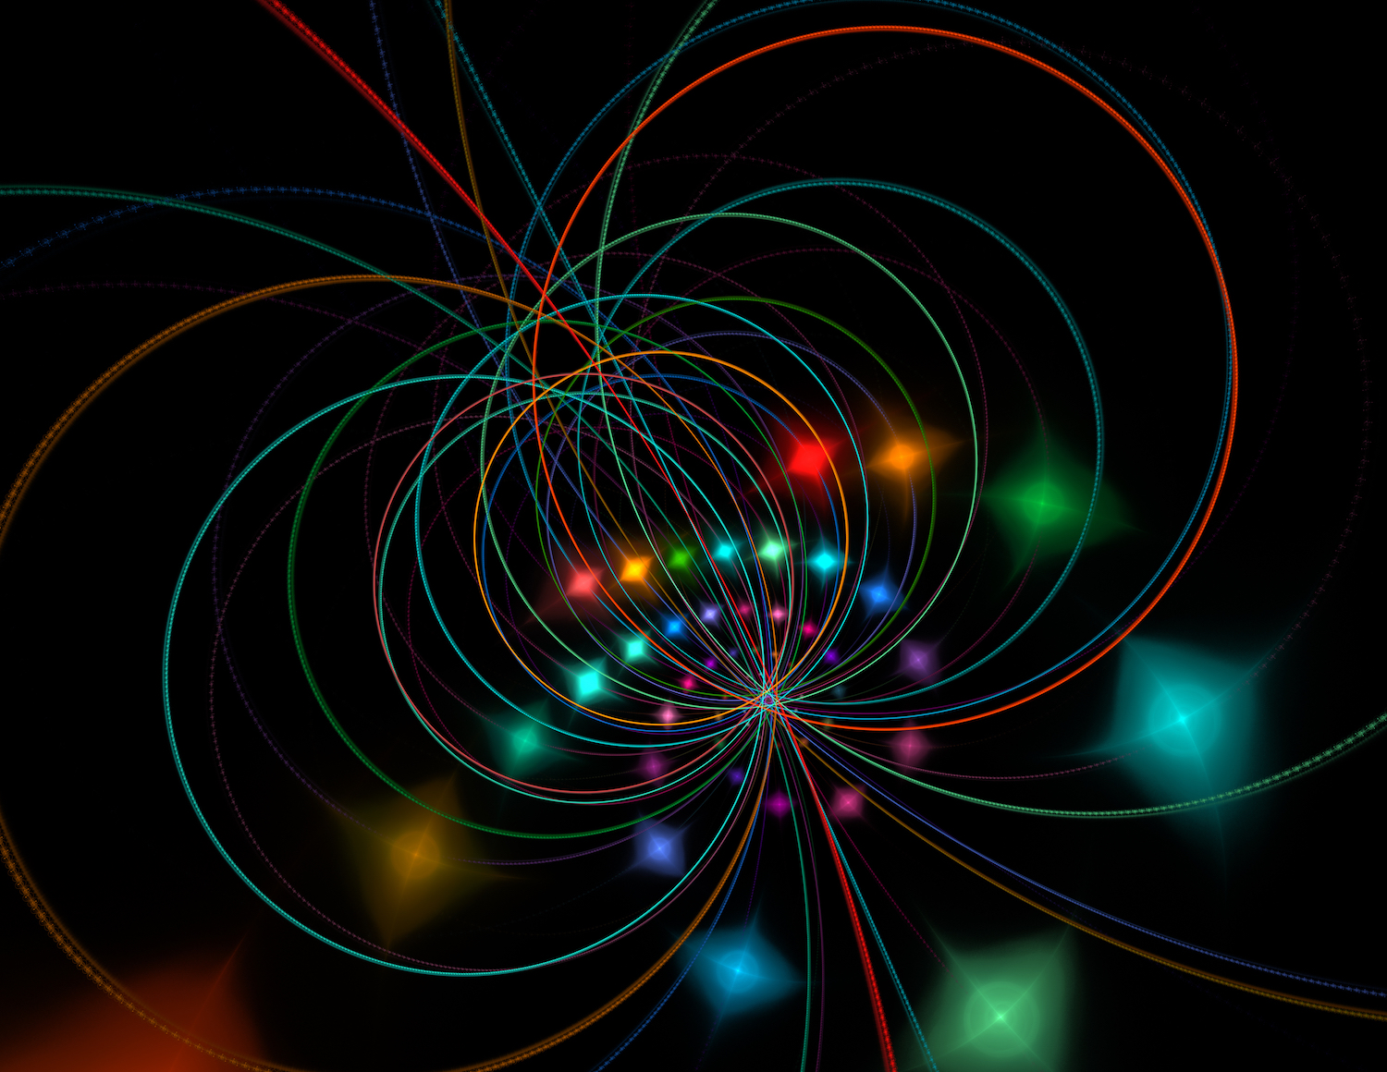
Falsificationism
Trouble lurks, however
A lot of credible theoretical physics (for example, String Theory) is, in principle, unfalsifiable (https://www.math.columbia.edu/~woit/wordpress/?p=533)
A lot of the entailments of the theory are only testable in extreme conditions (energy levels unattainable in our current particle colliders)
As such, might be viewed as unfalsifiable.
Are physicists working on String Theory pseudoscientists?
Even if you think they are, aren’t they doing something more rigorous (i.e., this isn’t the whole story to demarcation)?

Slide 39
Falsificationism
Another problem for falsificationism
In practice, we rarely reject well respected theories on the basis of a falsifying example.

Slide 40
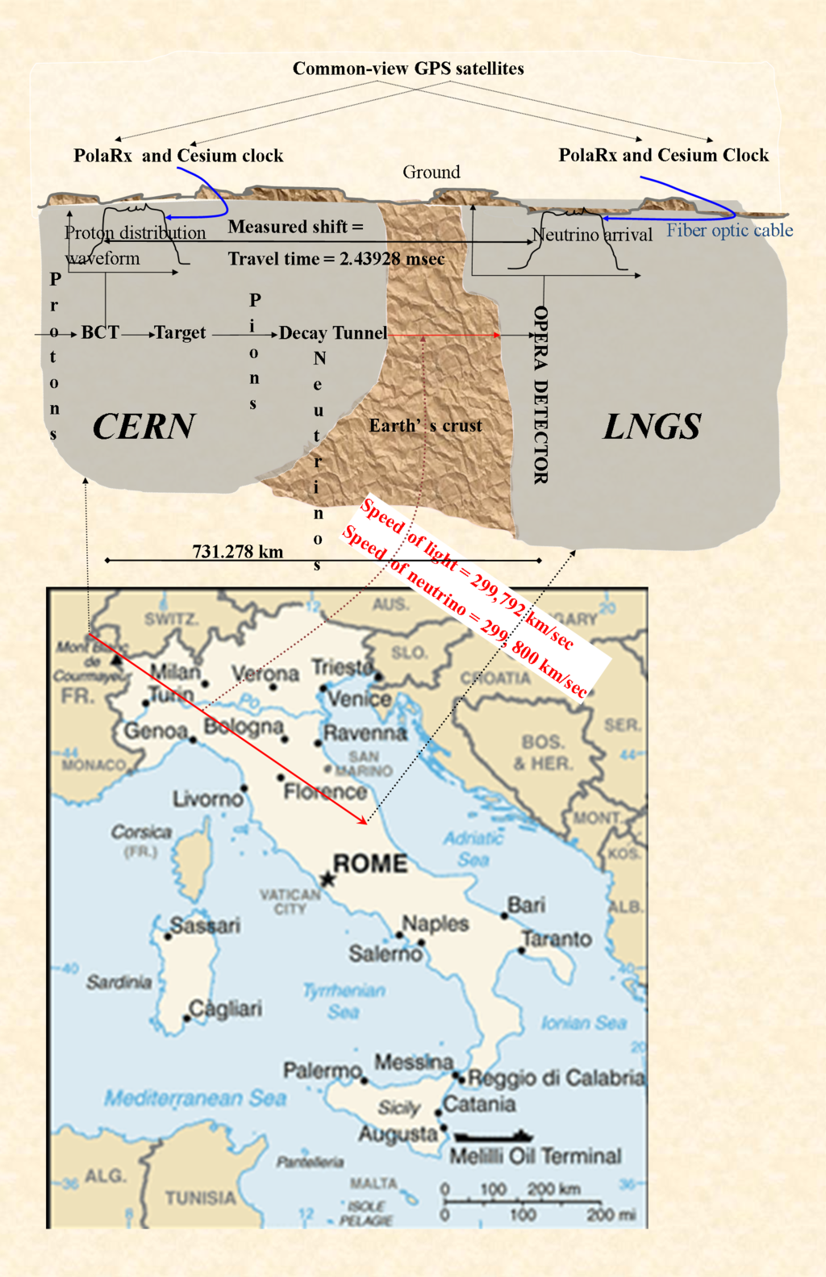
OPERA Experiment
In 2011, researchers at the CERN-affiliated OPERA Experiment at Laboratori Nazionali del Gran Sasso (LNGS) reported that they had evidence that neutrinos travelled faster than light.

Slide 41
OPERA Experiment
Neutrinos created at CERN were fired at a detector in Gran Sasso.
The speeds recorded were in excess of the speed of light.

Slide 42
OPERA Experiment
If correct, the findings would contradict relativity.
Neutrinos have small, but nonzero mass.
Theory of relativity – one of our most entrenched scientific theories – predicts that any entity with mass cannot travel faster than the speed of light.
The findings, if confirmed, would irrevocably change our fundamental understanding of the world.

Slide 43
OPERA Experiment
The findings were met with an enormous amount of incredulity in the scientific community.
In the end, it was confirmed that a faulty fibre optic cable, and a clock oscillator that ran too fast, were to blame for the anomalous results.
Once the experimental set up was corrected, it was confirmed that neutrinos travel within the margin of error for the speed of light.

Slide 44
OPERA Experiment
Should we not have rejected special relativity, on the basis of the OPERA experiment?
It seems we were entirely right to be sceptical of these incredible results, but Popper’s position is powerless to explain why.
After all, no theory is verifiable. It’s just not wrong.

Slide 45
Falsificationism
The relation between theory and prediction has not been represented accurately.
The correct relation, in this case, might be something more like:
P1. If special relativity is true, and if there is no faulty wiring, then when we fire a neutrino, it will travel less than the speed of light.
P2. We fire a neutrino, but it travels faster than the speed of light.
C. Special relativity is false.
More generally:
P1. If theory T is true, and if assumption A is true, then if condition C obtains, effect E is observed.
P2. Condition C obtains, but effect E is not observed.
C. Theory T is false.

Slide 46
Falsificationism
This formulation, however, is invalid:
P1. If theory T is true, and if assumption A is true, then if condition C obtains, effect E is observed.
P2. Condition C obtains, but effect E is not observed.
C. Theory T is false.

Slide 47
Falsificationism
T | A | C | E | (T&A) | -> | (C->E) | C & ~E | ~T
1 | 1 | 1 | 1 | 1 | 1 | 1 | 0 | 0
1 | 1 | 1 | 0 | 1 | 0 | 0 | 1 | 0
1 | 1 | 0 | 1 | 1 | 1 | 1 | 0 | 0
1 | 1 | 0 | 0 | 1 | 1 | 1 | 0 | 0
1 | 0 | 1 | 1 | 0 | 1 | 1 | 0 | 0
1 | 0 | 1 | 0 | 0 | 1 | 0 | 1 | 0
1 | 0 | 0 | 1 | 0 | 1 | 1 | 0 | 0
1 | 0 | 0 | 0 | 0 | 1 | 1 | 0 | 0
0 | 1 | 1 | 1 | 0 | 1 | 1 | 0 | 1
0 | 1 | 1 | 0 | 0 | 1 | 0 | 1 | 1
0 | 1 | 0 | 1 | 0 | 1 | 1 | 0 | 1
0 | 1 | 0 | 0 | 0 | 1 | 1 | 0 | 1
0 | 0 | 1 | 1 | 0 | 1 | 1 | 0 | 1
0 | 0 | 1 | 0 | 0 | 1 | 0 | 1 | 1
0 | 0 | 0 | 1 | 0 | 1 | 1 | 0 | 1
0 | 0 | 0 | 0 | 0 | 1 | 1 | 0 | 1

Slide 48
Falsificationism
Adjust the schema appropriately
This formulation, is valid:
P1. If theory T is true, and if assumption A is true, then if condition C obtains, effect E is observed.
P2. Condition C obtains, but effect E is not observed.
C. Special relativity is false, or assumption A is false.

Slide 49
Falsificationism
T | A | C | E | (T&A) | -> | (C->E) | C & ~E | ~T v ~A
1 | 1 | 1 | 1 | 1 | 1 | 1 | 0 | 0
1 | 1 | 1 | 0 | 1 | 0 | 0 | 1 | 0
1 | 1 | 0 | 1 | 1 | 1 | 1 | 0 | 0
1 | 1 | 0 | 0 | 1 | 1 | 1 | 0 | 0
1 | 0 | 1 | 1 | 0 | 1 | 1 | 0 | 1
1 | 0 | 1 | 0 | 0 | 1 | 0 | 1 | 1
1 | 0 | 0 | 1 | 0 | 1 | 1 | 0 | 1
1 | 0 | 0 | 0 | 0 | 1 | 1 | 0 | 1
0 | 1 | 1 | 1 | 0 | 1 | 1 | 0 | 1
0 | 1 | 1 | 0 | 0 | 1 | 0 | 1 | 1
0 | 1 | 0 | 1 | 0 | 1 | 1 | 0 | 1
0 | 1 | 0 | 0 | 0 | 1 | 1 | 0 | 1
0 | 0 | 1 | 1 | 0 | 1 | 1 | 0 | 1
0 | 0 | 1 | 0 | 0 | 1 | 0 | 1 | 1
0 | 0 | 0 | 1 | 0 | 1 | 1 | 0 | 1
0 | 0 | 0 | 0 | 0 | 1 | 1 | 0 | 1

Slide 50
Falsificationism
P1. If theory T is true, and if assumption A is true, then if condition C obtains, effect E is observed.
P2. Condition C obtains, but effect E is not observed.
C. Theory T is false, or assumption A is false.
The problem with this second formulation, however, is that we’re no longer required to accept the falsity of T.
As a result, we could always build in assumptions that we could ‘rest the blame’ on, so to speak.
That is, we could lay the fault for the failed prediction with the assumption, rather than the theory.

Slide 51
Falsificationism
And in many cases, these assumptions won’t be as ridiculous. For example:
According to Newtonian mechanics, two objects a and b, if released at the same time from the same height, will hit the ground at the same time.
That is, unless any wind resistance that slows their fall.
If there is no atmosphere, a feather and a cannonball will fall at the same speed.

Slide 52
Falsificationism
If we plug this into the theory:
P1. If theory T (Newtonian Mechanics) is true, and if assumption A (air resistance doesn’t slow the fall of objects a and b) is true, then if condition C (we drop objects a and b from the same height simultaneously) obtains, effect E (objects a and b hit the ground at the same time) is observed.
P2. Condition C obtains, but effect E is not observed.
C. Theory T is false, or assumption A is false.

Slide 53
Falsificationism
The problem here, however, is that, in other circumstances, we can build in whatever assumptions we want (that we can blame for the failure of the predicted effect to occur)
Those assumptions may grow increasingly outlandish
Imagine for example, someone claims they are amazing at football, and who comes up with increasingly tortured excuses for why, when you see them play, they’re rubbish.
Though it might be obvious to us, there’s no non-arbitrary criteria for us to use that says that the theory (that they’re good at football) is false, rather than the assumption (the fact that they got up too early, have a headache, sun got in their eyes, etc.)

Slide 54
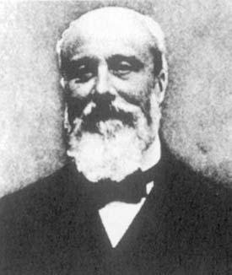
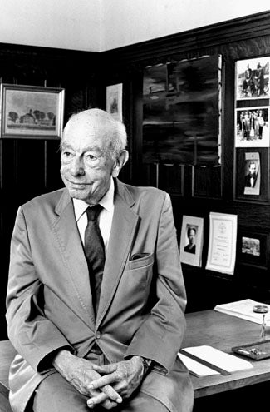
Duhem-Quine
This problem is closely related to the Duhem-Quine thesis
The idea is: it’s impossible to test a hypothesis in isolation
What you really do, is test the hypothesis, in conjunction with a background corpus of knowledge
When the hypothesis isn’t borne out in observation, it’s impossible to tell which of the two – hypothesis, or background assumptions – have been falsified.
To see this, switch ‘assumption A’ for ‘background knowledge’ in our previous schema

Slide 55
Falsificationism
In summary, then, significant problems exist for falsificationism.
It does however represent progress over the inductive/verification model of science.
That said, it has enduring popularity, so much so that it’s probably accurate to say it’s the received view amongst contemporary scientists.

Slide 56
The Empirical Cycle
It’s a model of how science actually proceeds.
Should bring together the multiple elements we’ve looked at in today’s lecture.
Now, you’ll be able to point out the multiple flaws that occur within this picture.

Slide 57
Empirical Cycle
Experimentation/Observation (Phase 1)
Generation (Phase 2)
Prediction (Phase 3)
Observation (Phase 4)
Evaluation (Phase 5)

Slide 58
The Empirical Cycle
Experimentation/Observation (Phase 1)
“there is the taking in of unsolicited facts, things that come to be known by just looking around and observing the world or by ‘toying’ with experimental set-ups in a laboratory, out of curiosity, or things observed accidentally while doing experiments aimed at other matters.”

Slide 59
Empirical Cycle
Generation (Phase 2)
“This first observational phase is followed by a reasoning phase: laws, theories, mechanisms are proposed that would account for the observed facts, unify them in some respect or explain them.”
What form of reasoning is going on here? Deductive or inductive?

Slide 60
Empirical Cycle
Prediction (Phase 3)
“Next, there comes another reasoning phase: once the laws, theories or mechanisms are articulated, consequences are derived from them, predictions concerning other facts that we must expect to obtain in particular circumstances if we are right about the theories and mechanism”
What form of reasoning here? Inductive or deductive?

Slide 61
Empirical Cycle
Observation (Phase 4)
“This… is followed by another phase of activity: this time a meticulous search for the circumstances in nature in which the predicted fact should be observable, or the careful construction of an experiment aimed at creating these circumstances in a laboratory, terminating in a record of what was actually observed.”
Is there any reasoning going on in Phase 4?

Slide 62
Empirical Cycle
Evaluation (Phase 5)
“This second empirical phase is followed by another reasoning phase, a phase of evaluation: given our observations, and the extent to which they match or fail to match the predictions derived from the proposed law or theory, what is the status of the latter? Can we go on to consider itas satisfactory accounts of nature’s ways, perhaps even as being true, or must we drop it?”

Slide 63
Empirical Cycle
Toy example:
I look around me, I notice that all Fs I’ve seen are also Gs (experimentation/observation).
From this, I develop the theory ‘all Fs are Gs’ (generation)
Someone comes along, hears about my theory, and notices that my theory entails the F that they know about must also be a G. (prediction)
They go and check whether their F is also a G (observation)
They confirm that the F is indeed a G, and my theory isn’t falsified (evaluation)

Slide 64
Next week (final week)
We’ll consider the question of whether or not we should believe our best scientific theories are true or not

